Slide 1

LINUX FORENSICS WORKSHOP
HOREA MOLDOVAN

Slide 2
ACQUISITION IMAGE DISQUE
04
ANALYSE HDD

Slide 3
SCENARIOS D’ACQUISITION DISQUES
04
Cloud public
Suivre les procédures des fournisseurs
Cloud privé
Snapshots et copies (qemu-image pour traduire)
Disque local
ewfacquire
dc3dd

Slide 4
GEOMETRIES DISQUE DIFFICILES
04
Linux veut du raw, pas du E01/AFF/split raw/VMDK...
Les couches de configuration confondent les outils forensiques
Volumes cryptés
RAID logiciel
Gestion logique des volumes
Les systèmes de fichiers sont souvent « dirty »

Slide 5
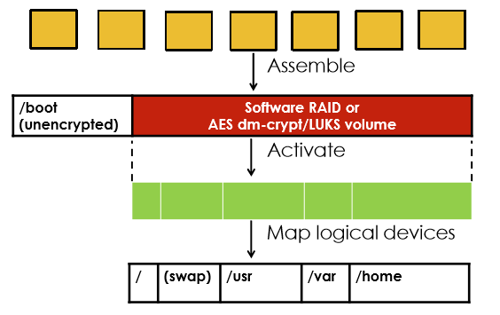
COUCHES DE COMPLEXITE
04
Fichiers Image E01
Image Brute
(Disque physique)
Volume LVM
Volumes disque
(partitions)

Slide 6
TRAVAILLER AVEC E01
04
# ls
case1-webserver_meta.sqlite Webserver.E01 Webserver.E01.txt case1-webserver_meta.xml Webserver.E01.csv
# mkdir –p /mnt/test/img
# ewfmount Webserver.E01 /mnt/test/img
ewfmount 20140608
# ls -lh /mnt/test/img
total 0 -r--r--r-- 1 root root 32G Feb 16 18:21 ewf1

Slide 7
QU'EST-CE QU'IL Y A DANS L'IMAGE ?
04
# mmls /mnt/test/img/ewf1
DOS Partition Table
Offset Sector: 0 Porbablement /boot
Units are in 512-byte sectors
Slot Start End Length Description
00: Meta 0000000000 0000000000 0000000001 Primary Table (#0)
01: ----- 0000000000 0000002047 0000002048 Unallocated
02: 00:00 0000002048 0000499711 0000497664 Linux (0x83)
03: ----- 0000499712 0000501759 0000002048 Unallocated
04: Meta 0000501758 0066064383 0065562626 DOS Extended (0x05)
05: Meta 0000501758 0000501758 0000000001 Extended Table (#1)
06: 01:00 0000501760 0066064383 0065562624 Linux LVM (0x8e)
07: ----- 0066064384 0066064607 0000000224 Unallocated

Slide 8
PLUS DE DETAILS
04
# fsstat -o 2048 /mnt/test/img/ewf1
FILE SYSTEM INFORMATION
-------------------------------------------
File System Type: Ext2
Volume Name:
Volume ID: 1e860db5dd43e2934d499ba1013b8832
Last Written at: 2019-10-05 05:41:51 (EDT)
Last Checked at: 2016-04-03 12:05:47 (EDT)
Last Mounted at: 2019-10-05 05:41:51 (EDT)
Unmounted Improperly
Last mounted on: /boot

Slide 9
PREPARER LE LOOPBACK
04
-r =« read only » offset (sortie mmls)
-f = premier disponible
# losetup -rf -o $((501760*512)) /mnt/test/img/ewf1
# losetup -a
/dev/loop0: [0020]:2 (/mnt/test/img/ewf1), offset 256901120
# file -s /dev/loop0
/dev/loop0: LVM2 PV (Linux Logical Volume Manager), UUID: SA3YAl91Rk-W5FA-cQGz-TnXl-J4yN-awbQjd, size: 33568063488

Slide 10
ACTIVER LVM
04
# pvdisplay /dev/loop0
--- Physical volume –
PV Name /dev/loop0
VG Name VulnOSv2-vg
PV Size 31.26 GiB / not usable 0
…
# vgscan
Reading all physical volumes. This may take a while...
Found volume group "RD" using metadata type lvm2
Found volume group "VulnOSv2-vg" using metadata type lvm2
# lvchange -a y VulnOSv2-vg
# lvscan | grep VulnOSv2-vg
ACTIVE '/dev/VulnOSv2-vg/root' [30.51 GiB] inherit
ACTIVE '/dev/VulnOSv2-vg/swap_1' [768.00 MiB] inherit

Slide 11
VERIFIER LE FILE SYSTEM
04
# fsstat /dev/VulnOSv2-vg/root
FILE SYSTEM INFORMATION
-------------------------------------------
File System Type: Ext4
Volume Name:
Volume ID: 46c34db340bee5aa35423fd055183259
Last Written at: 2019-10-05 05:41:50 (EDT)
Last Checked at: 2016-04-03 12:05:48 (EDT)
Last Mounted at: 2019-10-05 05:41:50 (EDT)
Unmounted properly
Last mounted on: /
…

Slide 12
FILE SYSTEM SALE
04
# mkdir /mnt/test/data
# mount -o ro,noexec /dev/VulnOSv2-vg/root /mnt/test/data
mount: wrong fs type, bad option, bad superblock on /dev/mapper/Vuln… missing codepage or helper program, or other error In some cases useful info is found in syslog - try dmesg | tail or so
# dmesg | tail
[13458…] EXT4-fs (dm-6): INFO: recovery required on readonly filesystem
[13458…] EXT4-fs (dm-6): write access will be enabled during recovery
[13458…] Buffer I/O error on device dm-6, logical block 0 [13458…] lost page write due to I/O error on dm-6 …
[13458…] JBD2: recovery failed
[13458…] EXT4-fs (dm-6): error loading journal

Slide 13
LE PETIT SECRET
04
# mount -o ro,noexec,noload /dev/VulnOSv2-vg/root /mnt/test/data
# ls /mnt/test/data
bin dev home lib media opt root sbin sys usr boot etc initrd.img lost+found mnt proc run srv tmp var
#
# mount -o ro,noexec,loop,offset=$((2048*512)) /mnt/test/img/ewf1 /mnt/test/data/boot
# ls /mnt/test/data/boot
abi-3.13.0-24-generic memtest86+.bin
config-3.13.0-24-generic memtest86+.elf
grub memtest86+_multiboot.bin
initrd.img-3.13.0-24-generic System.map-3.13.0-24-generic
lost+found vmlinuz-3.13.0-24-generic

Slide 14
DEFAIRE TOUT
04
# umount /mnt/test/data/boot
# umount /mnt/test/data
#
# vgchange -a n VulnOSv2-vg
0 logical volume(s) in volume group "VulnOSv2-vg" now active
#
# losetup -d /dev/loop0
#
# umount /mnt/test/img

Slide 15
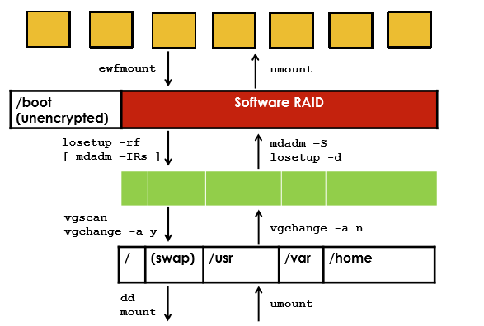
COMMANDES PAR COUCHE
04
mmls
fsstat
file
cat /proc/mdstat
pvdisplay
lvscan
fsstat

Slide 16
LAB 04
04
MONTAGE DES DISQUES

Slide 17

LA SEMAINE PROCHAINE: TRIAGE RAPIDE DU DISQUE
Notes:
© Copyright Showeet.com – Creative & Free PowerPoint Templates

